Slide 1


ABAP on Hana s/4 Hana Training
Day 9
contact@anubhavtrainings.com

Slide 2

Agenda – Day 9
Describing Data Objects in SQL Script ( Variables )
Concept of Procedure
Create Procedure
Update Procedure
Delete Procedure
Concept of Cursor
Making Procedure with parameters
Making Anonymous Block in HANA Database
Reuse Function for SQL queries

Slide 3
Data Objects in SQL Script ( Variables )
2
Array
List of values of single data type
DECLARE arr datatype ARRAY;
3
1
Scaler
Table Type
Used to store single value
Syntax:
DECLARE varname vtype;
Numbers – INT, BIGINT, TINYINT, DECIMAL
Char – VARCHAR, NVARCHAR, CHAR, STRING
Date – DATE, TIMESTAMP
Other – BLOB, CLOB.
2 type of Table types
Implicit
Explicit
Data Variables

Slide 4
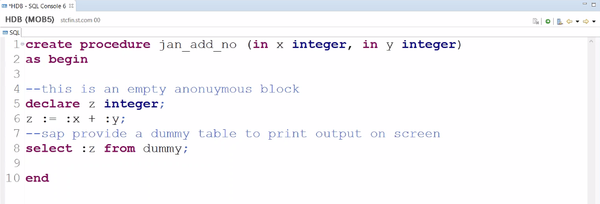
Concept of Procedure
A procedure is a unit/module that perform a specific task. This procedure can be combined to form larger programs. This basically forms the 'Modular Design'. A procedure can be invoked by another procedure which is called the calling program.
Procedures are re-useable processing block with a specific sequence of data transformation. The procedure can have multi-input/output parameters. The procedure can be created as read-only or read-write.

Slide 5
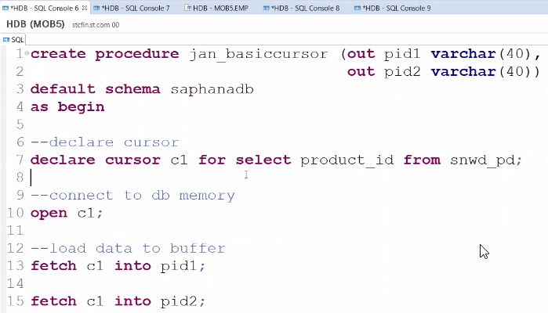
Cursor
Cursor is used to fetch single rows from the result set returned by a query. Cursors can be defined either after the signature of the procedure and before the procedure's body or at the beginning of a block with the DECLARE token. The cursor provides the functionality to iterate through a query result row-by-row.
You can name a cursor so that it could be referred to in a program to fetch and process the rows returned by the SQL statement, one at a time.
There are two types of cursors −
Implicit cursors
Explicit cursors
A cursor is assigned to a query. We can traverse over record by record.
Steps:
Declare
Open
Fetch
Close

Slide 6

Exercise
SQL Script Advance

Slide 7
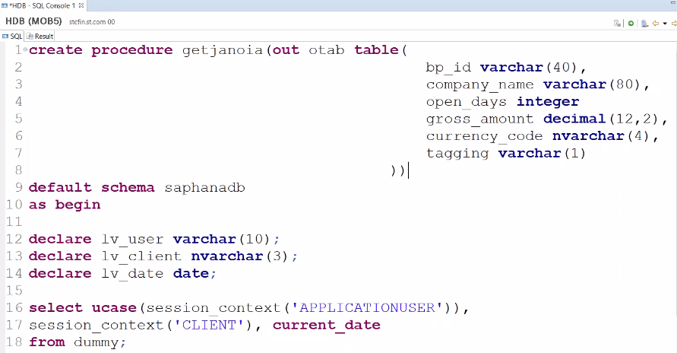
Anonymous Block in HANA
An anonymous block is an executable DML statement which can contain imperative or declarative statements and is
defined and executed in a single step.
All SQLScript statements, supported in procedures, are also supported in anonymous blocks.

Slide 8


Exercise
OIA Using SQL Script Advance

Slide 9
Procedure Proxy
The database procedure proxy defines the mapping between the database types of the parameter interface of the SQLScript procedure and ABAP data types. The following table lists the currently supported HANA-specific data types
and indicates which ABAP Dictionary types they are mapped to by default.
HANA Transport Container
ABAP Layer
ABAP Layer
Transport
HTC
Mr. X
AMDP
Mr. X
AMDP
HTC
ABAP Code
Procedure Proxy
ABAP Code
Procedure Proxy
Top Down Approach
Bottom-up approach
HANA Layer
HANA Layer
procedure
DU
IM
HANA Procedure
procedure
HANA Procedure

Slide 10

End of Day 9
Trainer: Anubhav Oberoy & Shubham Singh

Slide 11

Trainer: Anubhav Oberoy & Shubham Singh

Slide 12
THANK YOU
If you cannot do
great things, do small things in a great way.
Anubhav Oberoy
https://www.anubhavtrainings.com

Slide 13


We’re committed to empower you to be
Most Desirable Resource
through powerful training solutions.
We build the workforce of the future.
250+
Corporate Clients
30,000+
Learners Trained
25000+
Learners Placed
FREE WEBINARS
Sign up for free webinars with industry experts every fortnight!
Enroll Now!
Contact us today!
https://anubhavtrainings.com/

Slide 14




More from AnubhavTrainings.com

